Slide 1
Day 1. Introduction to LabView
Prepared by:
Alexander De Los Reyes
29 March 2019

Slide 2
What is LabVIEW?
Laboratory Virtual Instrument Engineering Workbench (LabVIEW) is a graphical programming language that uses icons instead of lines of text to create programs.
You can use a software development method to create LabVIEW solutions.
This method helps programmers in developing code that has greater potential to solve a problem as compared to writing code without a plan.
This method also helps to make code more readable, scalable, and modifiable.

Slide 3
Virtual Instruments (.vi)
Programs created using LabVIEW are called virtual instruments (VIs).
This is because the appearance and operations of these programs imitate physical instruments, such as oscilloscopes and multimeters.
These programs are saved with a .vi extension.
LabVIEW contains a comprehensive set of VIs and functions for acquiring, analyzing, displaying, and storing data.
It also contains tools to help you troubleshoot your code.

Slide 4
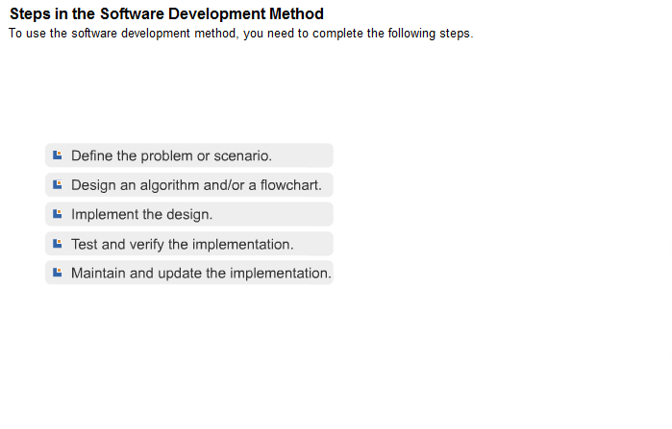

Slide 5
LET US START! ☺
STEP 0. OPEN LABVIEW

Slide 6
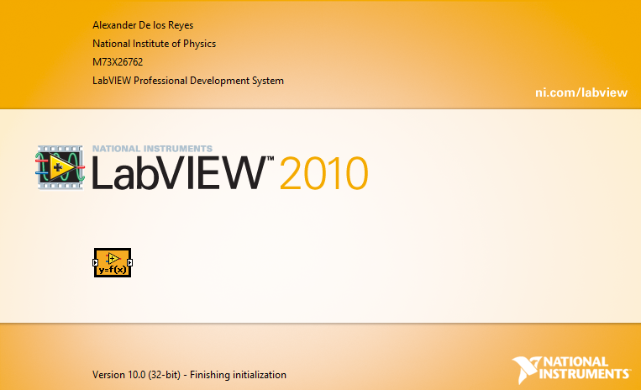
Introduction to LabVieW
Notes:
LabVIEW – Laboratory Virtual Instruments Engineering Workbench
M73X26762

Slide 7
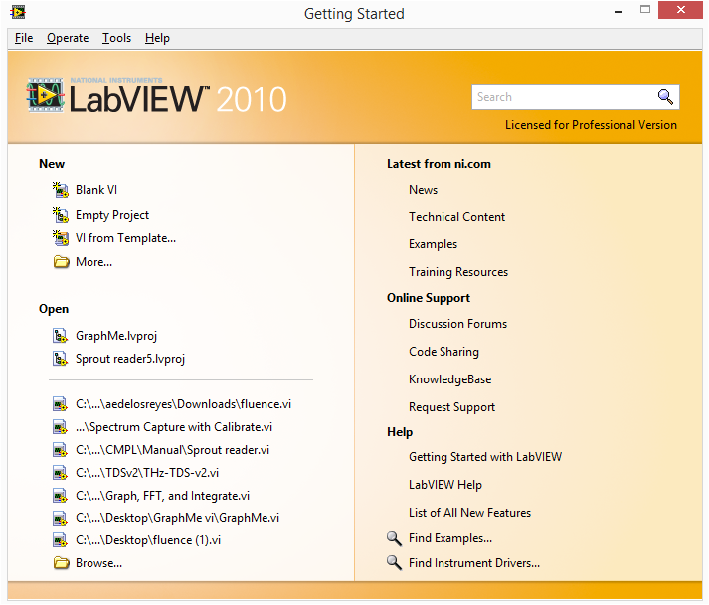
Introduction to LabVieW
Notes:
LabVIEW – Laboratory Virtual Instruments Engineering Workbench
M73X26762

Slide 8
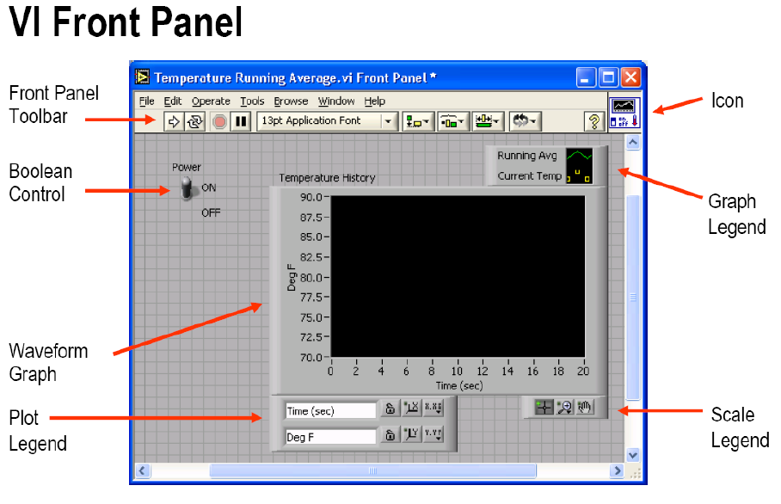

Slide 9
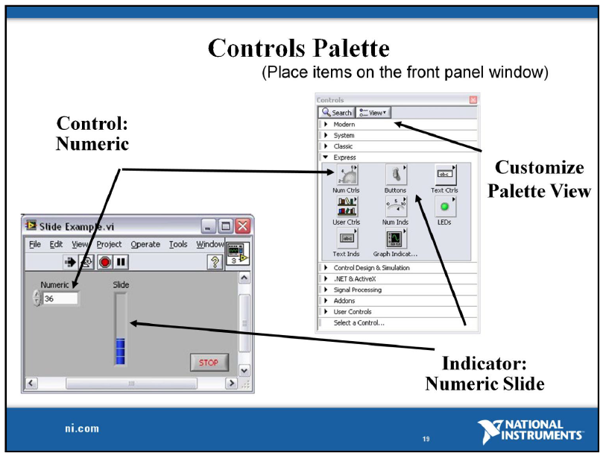
Notes:
Controls Palette
The Controls palette contains the controls and indicators you use to create the front panel. You access the Controls palette from the front panel window by selecting View»Controls Palette. The Controls palette is broken into various categories. You can display some or all of these categories or subpalettes to suit your needs. The Controls palette with all the categories exposed and the Modern category expanded is displayed.

Slide 10
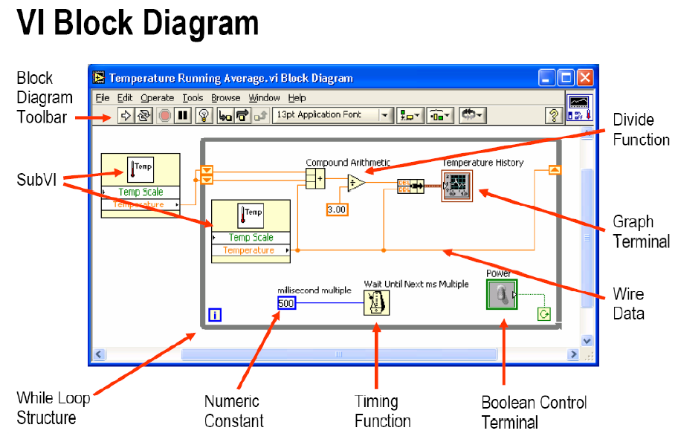

Slide 11
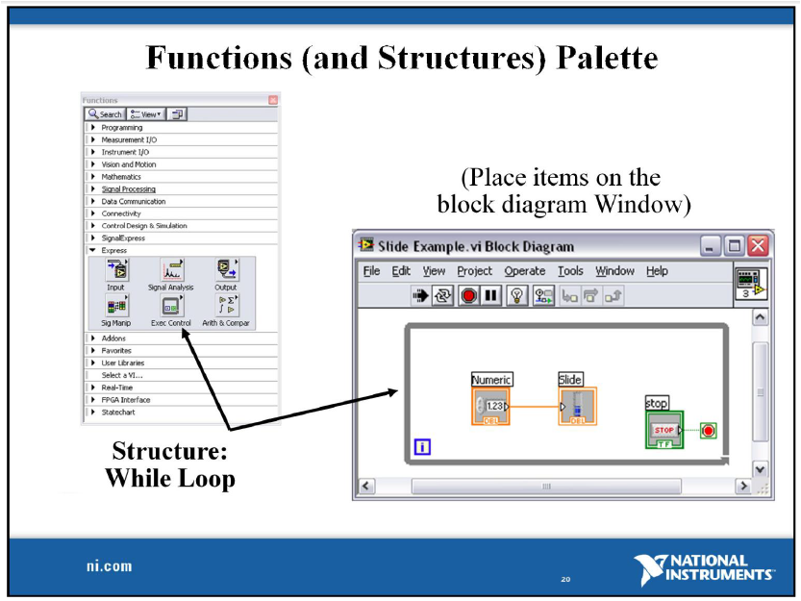

Slide 12
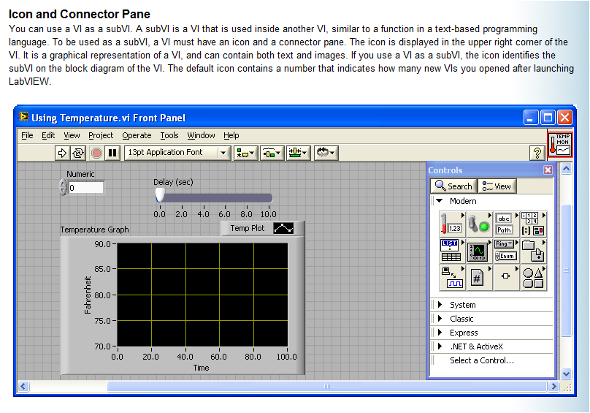

Slide 13
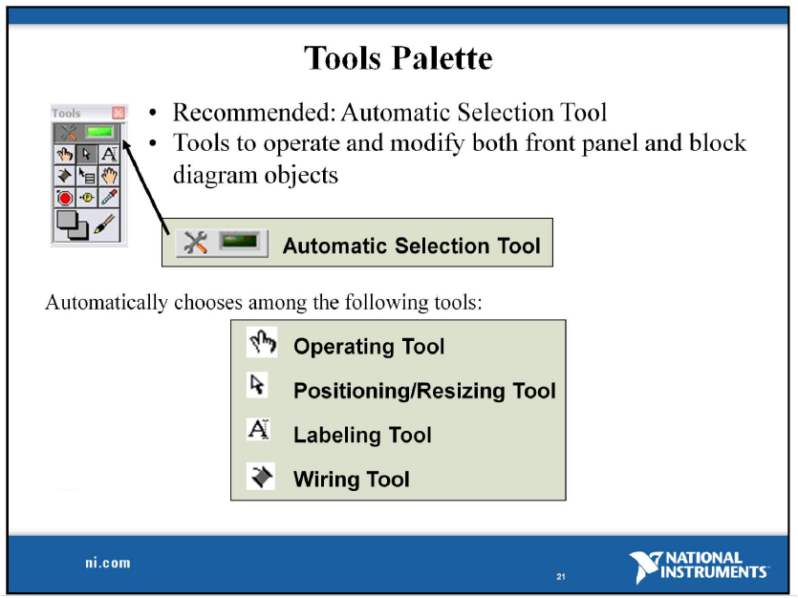

Slide 14
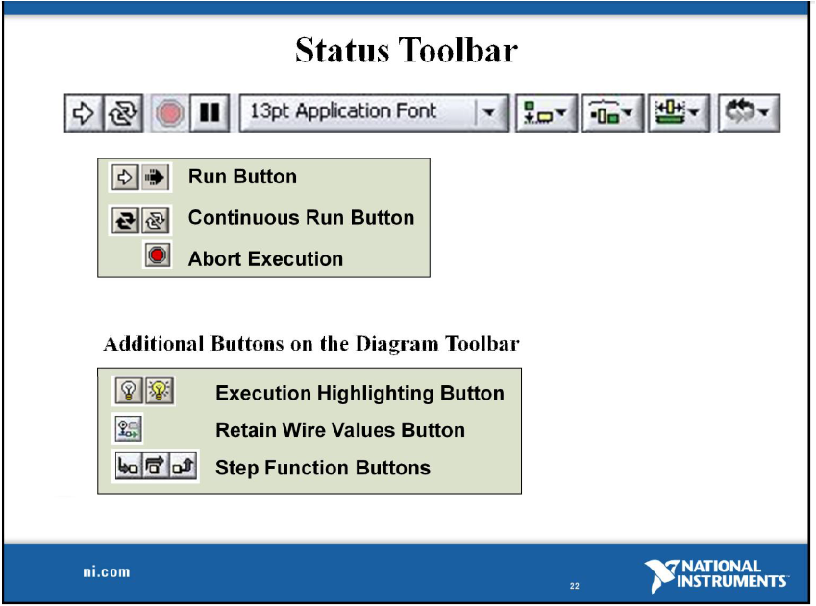

Slide 15
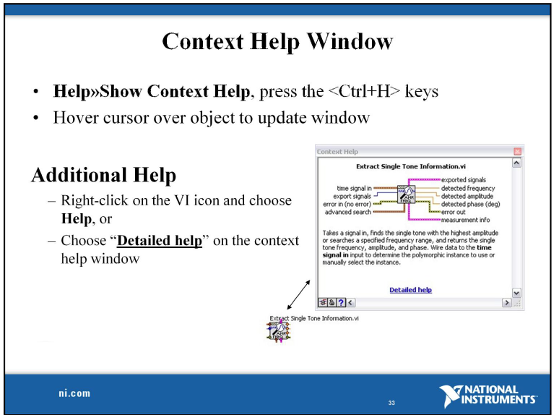

Slide 16
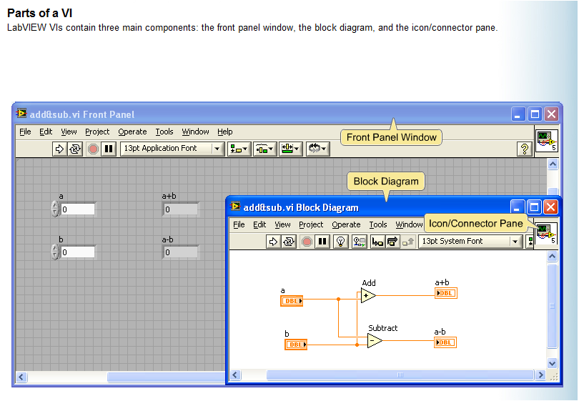

Slide 17

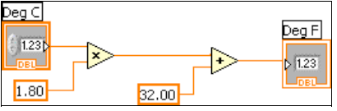
Exercise 1. Your First LabVIEW Program. A temperature converter

Slide 18
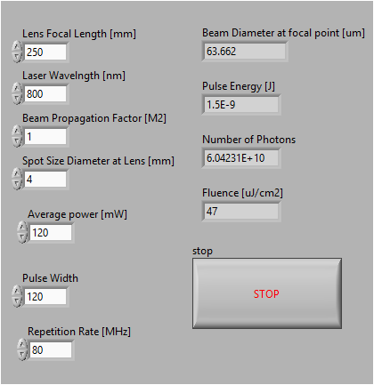
More examples

Slide 19
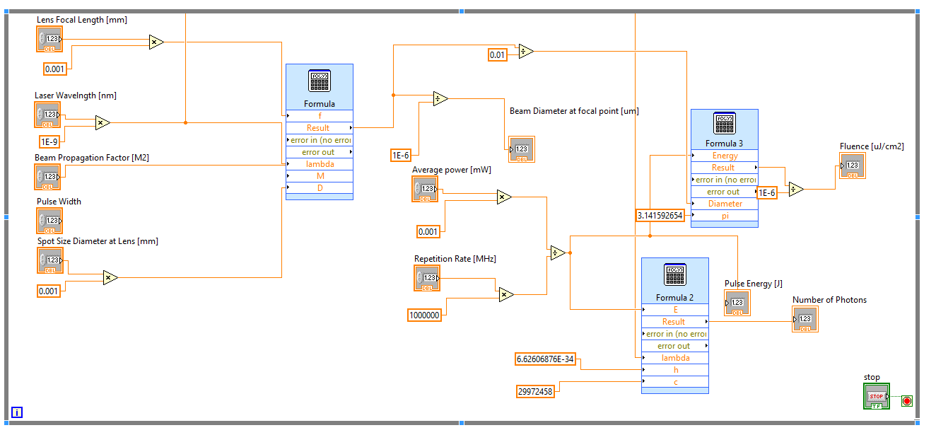
More examples

Slide 20
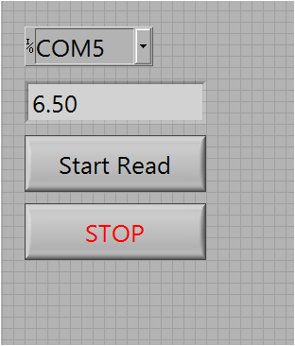
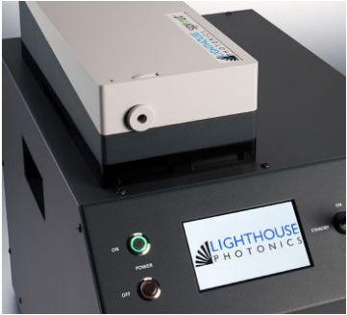
Some LabVIEW Examples

Slide 21
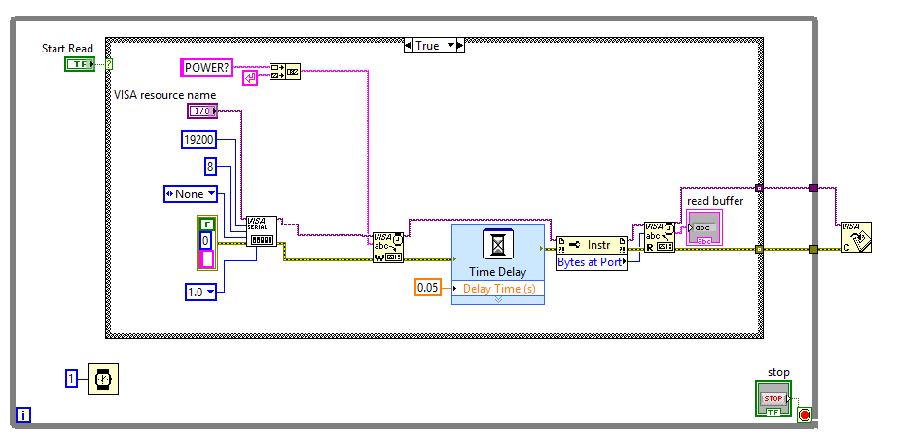
Some LabVIEW Examples

Slide 22
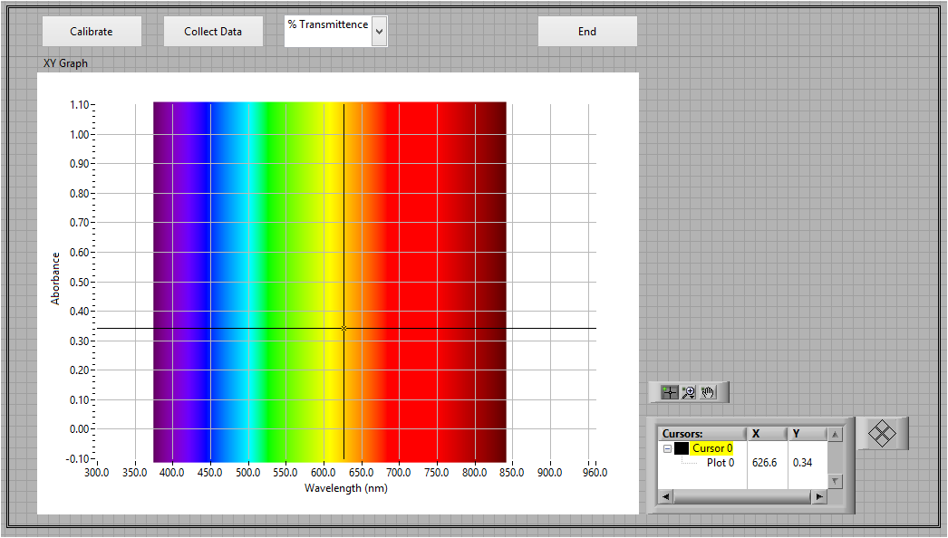
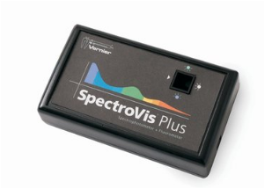
Some LabVIEW Examples

Slide 23
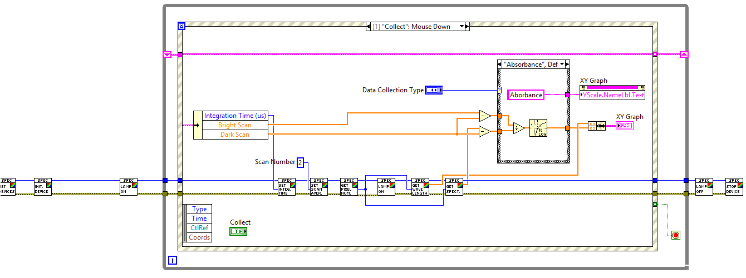
Some LabVIEW Examples

Slide 24
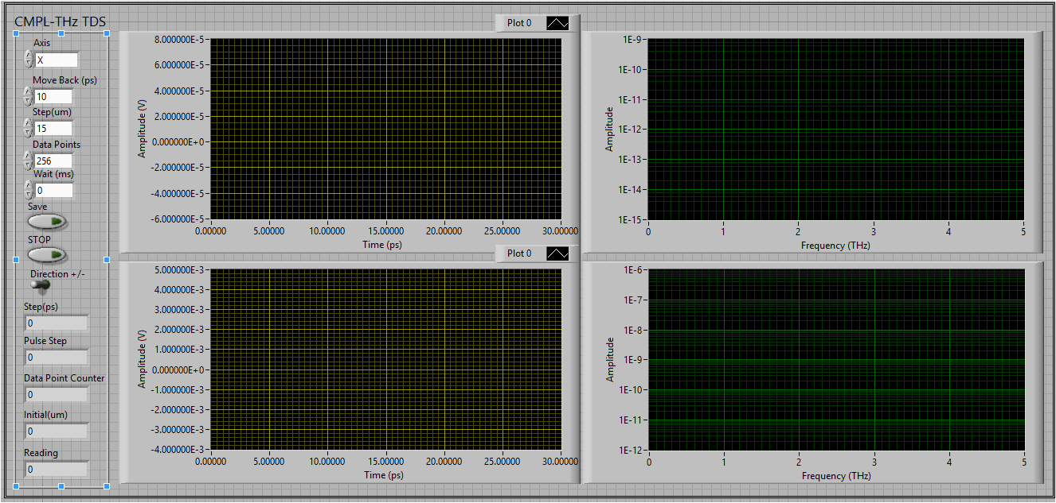
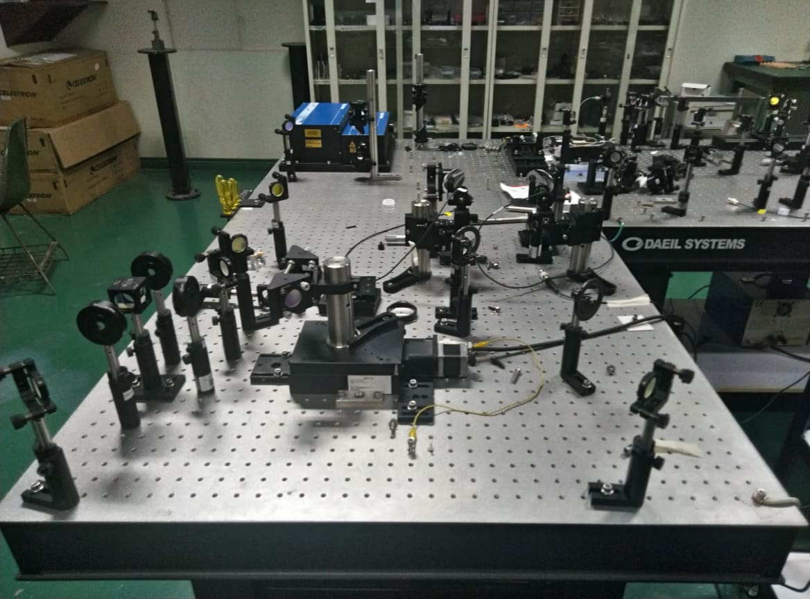
Some LabVIEW Examples

Slide 25
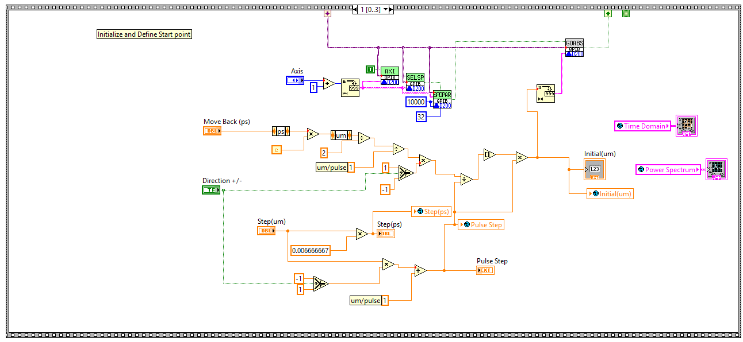
Some LabVIEW Examples

Slide 26
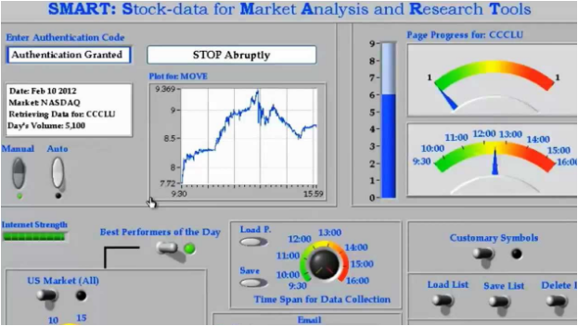
Some LabVIEW Examples

Slide 27
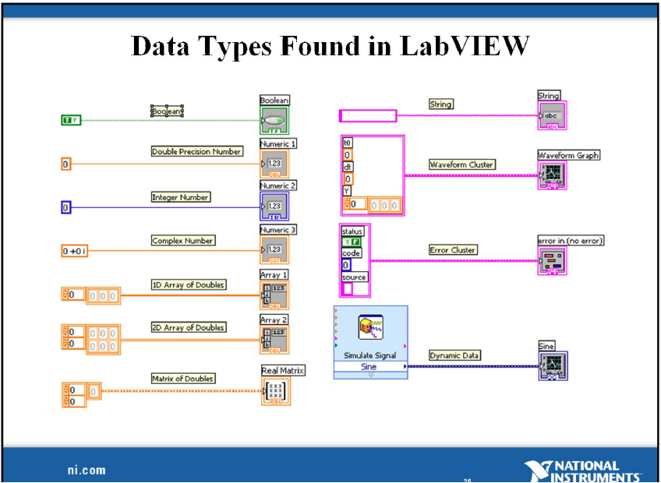

Slide 28
Quiz. (Individual, ¼ yellow pad, closed notes, no cheating)
1. _______ refers to the part of a vi where the user interface is found. Controls, indicators, inputs and outputs are found in this window

Slide 29
Quiz. (Individual, ¼ yellow pad, closed notes, no cheating)
2. _______ refers to the part of a vi where you add code using graphical representations, serving as building blocks of your program.

Slide 30
Quiz. (Individual, ¼ yellow pad, closed notes, no cheating)
3. _______ is a window that provides tips and useful information when a particular icon in the block diagram is pointed/clicked.

Slide 31
Quiz. (Individual, ¼ yellow pad, closed notes, no cheating)
4. What is our LabVIEW license code?

Slide 32
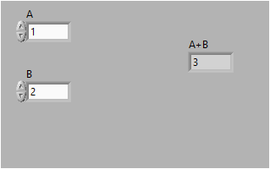
Quiz. (Individual, ¼ yellow pad, closed notes, no cheating)
5. Sketch the block diagram for this vi.

Slide 33
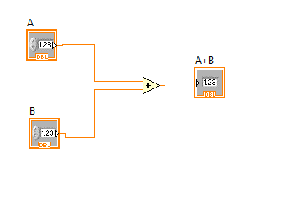
ANSWERS (1 pt each)
1. FRONT PANEL
2. BLOCK DIAGRAM
3. CONTEXT HELP
4. M73X26762
5.

Slide 34
REMINDERS
Groupings: Physics 192 groupmates.
At least one person should have LabVIEW in his/her laptop
For the next four (Day 2 – Day 5) meetings, there will be a seatwork to be accomplished by each group.
For Day 6, we will have your LabVIEW exam.

